Slide 1
Topic: Introduction of Problem Solving
Symbiosis Institute of Technology, Nagpur
Department of Computer Science and Engineering

Slide 2
Problem Solving
What is a Problem?
Anything that you are trying to Solve is Problem
How is a Problem Defined?
A problem is defined with some set of inputs, and the desired output
For Example: Given X, Determine Y
Define the Problem
Generate new Idea
Evaluate & Select Solutions
Implement & Evaluate
What is a Problem Solving?
It is the act of defining Problem,
Determining the cause of the problem,
Identifying, prioritizing, and selecting alternatives for a solution,
Implementing a solution

Slide 3



Programming
Writing series of instructions for Computer to accomplish a task
Instructions must be written in a way the Computer can understand
Programming Languages are used to write programs
If a code is written it must be executed
Run (keywords) can be used for execution
Some languages(java/c++) requires code to be translated/compiled before it can be started
Others Languages (javascript, python) are interpreted, each line translated separately
Standup
Instructor/
Programmer
Student/
Machine
SitDown

Slide 4
Computational Thinking
Computational Thinking is the fundamental skill everyone will use or is using
What is Computing?
Computing is the AUTOMATION of ABSTRACTION
Mathematical Formulation of Real-World Phenomenon
Computational Thinking focuses on the Process of ABSTRACTION
Ignoring Irrelevant details (layer 1)
Encapsulating the details of importance (layer 2)
Choosing the right abstraction
Operating in terms of multiple layers of abstraction simultaneously
Defining the relationships between layers
Automation
Machine
Human
Human + Machine
Network of Machine & Human
Abstraction
Notes:
Computers can be used to help us solve problems. However, before a problem can be tackled, the problem and the ways in which it could be solved needs to be understood. Computational thinking allows us to do this. It allows us to take a complex problem, understand what the problem is and develop possible solutions.

Slide 5
Measure of “Good” Abstraction
Efficiency
Correctness
How Fast?
How much space?
How much Power?
Does it do the right thing?
Does it produce an answer? (Halting Problem)
Other Qualities
Is it Usable?
Is it Modifiable?
Is it Maintainable?
Is it too costly?
Is it simple & elegant?
Notes:
Computers can be used to help us solve problems. However, before a problem can be tackled, the problem and the ways in which it could be solved needs to be understood. Computational thinking allows us to do this. It allows us to take a complex problem, understand what the problem is and develop possible solutions.

Slide 6
Computational Thinking: What it is and is not?
Key Components of Computational Thinking:
Decomposition:
Breaking down a problem into smaller, more manageable sub-problems or tasks.
Pattern Recognition:
Identifying trends, commonalities, or patterns within data or problems to simplify the solution process.
Abstraction:
Focusing on the essential details while ignoring irrelevant information, creating a simplified representation of the problem.
Algorithmic Design:
Developing a step-by-step solution or set of instructions to solve a problem, much like creating a recipe.
What Computational Thinking is NOT:
Programming-only:
Computational thinking is not limited to programming. While coding is a useful application, CT is a broader problem-solving approach applicable in various disciplines.
Technology-exclusive:
CT is not exclusive to technology fields. Its principles can be applied in diverse areas, such as business, science, and everyday life.
Reserved for Experts:
CT is not only for computer scientists or experts. It is a skill that can be developed and applied by individuals from various backgrounds and age groups.

Slide 7
Computational Thinking
Formulating a Problem
Expressing its solution
Computer, Human, or Machine
For Example:
Brushing Teeth
Reaching Home to College, etc
Notes:
Being able to turn a complex problem into one we can easily understand is a skill that is extremely useful. In fact, it’s a skill you already have and probably use every day

Slide 8
Computational Thinking: An Example
Let’s say you need to decide what to do with your class. If all of you like different things, you would need to decide:
What you could do?
Where you could go?
Who wants to do what?
What have you previously done that has been a success in the past?
How much money you have and the cost of any of the options?
How much time you have?
From this information, you and your class could decide more easily where to go and what to do – in order to keep most of your friends happy. You could also use a computer to help you to collect and analyze the data to devise the best solution to the problem, both now and even in a future scenario.
Four Key Techniques of Computational Thinking
Decomposition → Pattern Recognition → Abstraction → Algorithms
Notes:
Being able to turn a complex problem into one we can easily understand is a skill that is extremely useful. In fact, it’s a skill you already have and probably use every day

Slide 9
Example: Planning a Vacation Trip
1. Decomposition: Break down the task into smaller components: destination selection, budget planning, itinerary creation, accommodation booking, and packing.
2. Pattern Recognition: What have you previously done that has been a success in the past
3. Abstraction: Simplify the planning process by focusing on key elements like destination preferences, budget constraints, and the need for transportation and accommodation.
4. Algorithmic Design:
Identify destination preferences.
Set a budget for the trip.
Research and choose accommodation.
Plan the itinerary with activities and attractions.
Arrange transportation.
Pack essentials based on the destination and planned activities.
Outcome:
By applying computational thinking, the vacation planning process becomes more organized and manageable. Each step is clearly defined, making it easier to execute and adapt the plan as needed.

Slide 10
Problem 2: To find the sum of all numbers between 1 to 200
Step 1: Decomposition
Breaking complex problems into smaller and more manageable parts
1+2=3
3+4=7
5+6=11… and so on
200+1=201
199+2=201
198+3=201
197+4=201…and so on


Slide 11
Step 2: Pattern Recognition
Problem 2: To find the sum of all numbers between 1 to 200
Identification of patterns or trends within a problem
Therefore, we identified output of all nos. =201
Adding largest and smallest number, then adding second and second last number and so on…
We need to figure out how many such patterns we need?
i.e. Highest number/2
200/2=100 such pairs

Slide 12
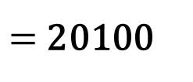
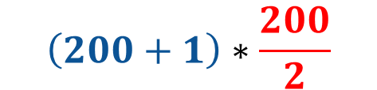
Step 3: Pattern Abstraction
Problem 2: To find the sum of all numbers between 1 to 200
Identify specific similarities & differences among similar problems, to work towards a solution
$$\left(200+1\right)∗\frac{200}{2}$$
All pairs have same SUM
$=$ 20100
No. of Pairs
Sum of Each Pair

Slide 13
Step 4: Algorithm Design
Problem 2: To find the sum of all numbers between 1 to 200
Developing step by step instructions for solving the problem.
These steps can be used again to solve similar problems
Step 1: X = N + 1
Step 2: Y = N/2
Step 3: Result = X * Y

Slide 14
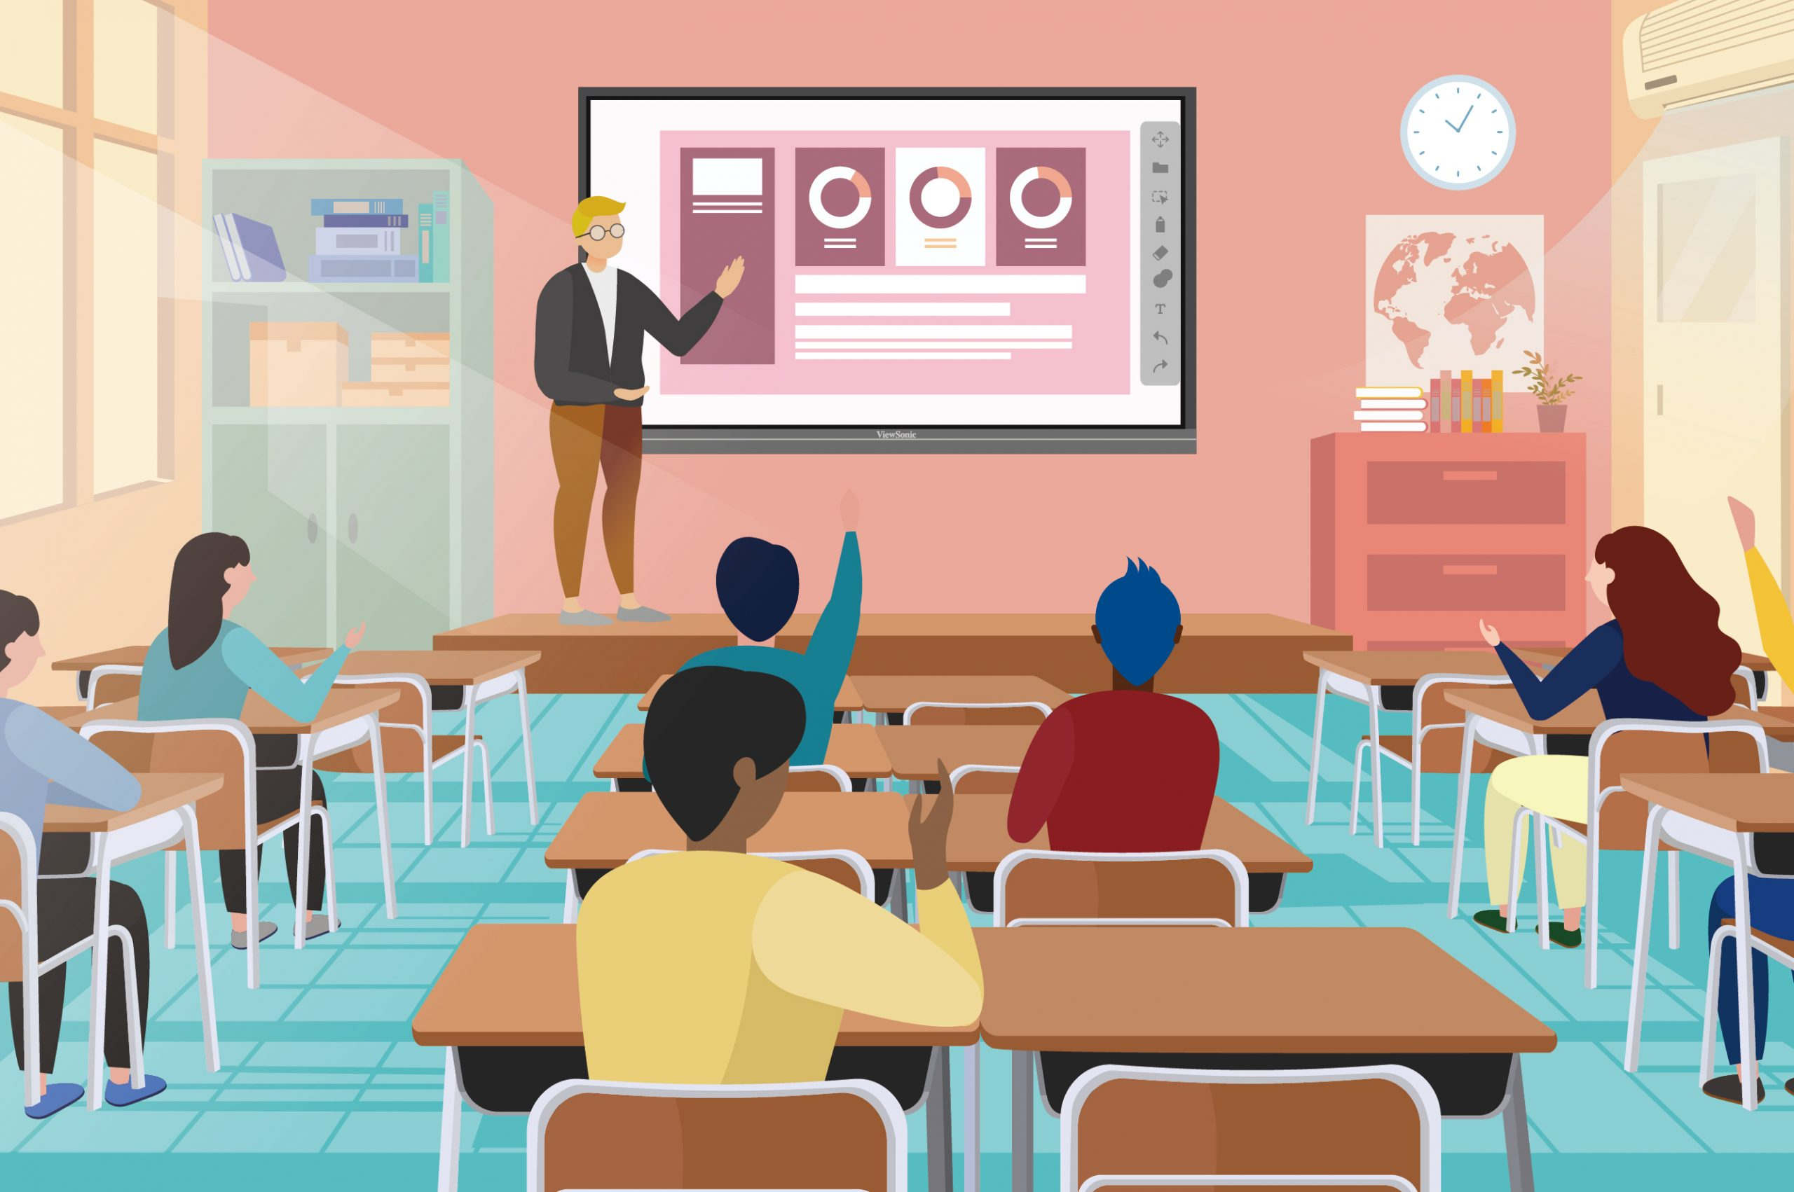
What is the total cost to construct a class room of 60 students
Task 1

Slide 15
What is the total cost to construct a class room of 60 students
Task 1
1. Decomposition: Break down the task into smaller components: construction materials, labor costs, furniture, and miscellaneous expenses.
2. Pattern Recognition: Recognize that constructing a classroom involves common elements like building materials, labor, and furnishings, which contribute to the overall cost.
3. Abstraction: Simplify by focusing on key cost components - construction materials, labor, and furnishings - without getting into overly detailed specifics.
4. Algorithmic Design:
Estimate the cost of construction materials (bricks, cement, etc.).
Calculate labor costs based on the number of workers and hours needed.
Determine the cost of furniture and equipment.
Add miscellaneous expenses (permits, utilities, etc.).
Sum up all these costs to find the total construction cost.
Solution:
Let's consider hypothetical values:
Construction Materials: ₹ 50,000
Labor Costs: ₹ 20,000
Furniture and Equipment: ₹ 20,000
Miscellaneous Expenses: ₹ 7,000
Total Cost = Construction Materials + Labor Costs + Furniture + Miscellaneous Expenses
Total Cost = ₹ 50,000 + ₹ 20,000 + ₹ 20,000 + ₹ 7,000 = ₹ 97,000 ≈ ₹ 1,00,000

Slide 16
Algorithm
Logical step by step method to solve a problem.
It is a procedure to solve a problem.
Algorithm is the first step of the process.
Used to solve a mathematical or computer problem.
Algorithm includes calculations reasoning and data processing.

Slide 17
Example
Write an algorithm for adding three numbers
Step 1: Start
Step 2: Read num1, num2, num3
Step 3: Result= num1+num2+num3
Step 4: Print Result
Step 5: End

Slide 18
Characteristics and Advantages
Characteristics
Clear and Unambiguous : Steps, input/output must be clear and must lead to one meaning.
Finiteness : Algorithm must terminate after finite number of steps.
Feasibility: Should be feasible with available resources
Independent: Algorithm must be independent of any programming code
Advantages
Easy to understand motive of program.
Helps in searching/ identifying the error.
Helps in correcting the error.
Complex problem in an easy way as it represents step for solving a problem.

Slide 19
Flowchart
A graphical or pictorial representation of an algorithm with the help of different symbols, shapes and arrows to demonstrate a process or a program.
The main purpose of flowchart is to analyze different methods.
Symbols used in flowchart are:
Terminal box- Start / End
Input/Output
Connector/Arrow
Process/ Instructions
Decision

Slide 20
Problem Statements
Design an algorithm and flowchart for the following:
Compute the average of three numbers.
Determine whether the number given by the user is odd or even.
Find the largest among three numbers given by the user.

Slide 21
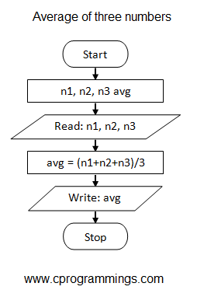
Problem Statements

Slide 22
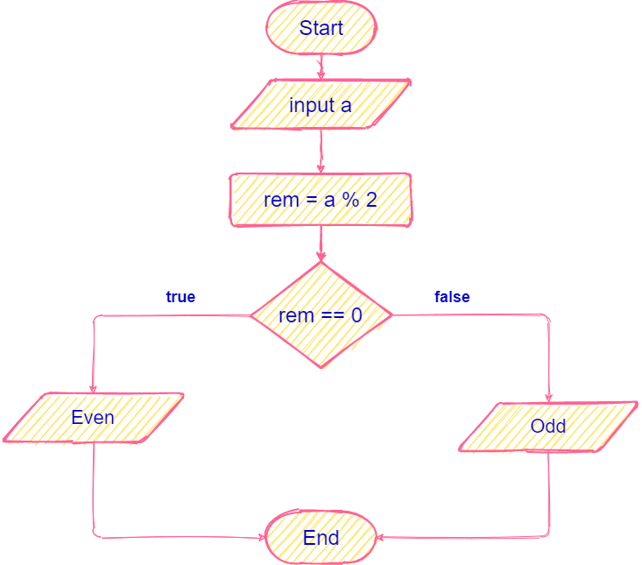
Problem Statements

Slide 23
Objectives of Problem solving
Identify
Develop
Execute
Assess

Slide 24
Computer system
Computer system can be divided into four components
Hardware – provides basic computing resources
CPU, memory, I/O devices
Operating system
Controls and coordinates use of hardware among various applications and users
Application programs – define the ways in which the system resources are used to solve the computing problems of the users
Word processors, compilers, web browsers, database systems, video games
Users
People, machines, other computers

Slide 25
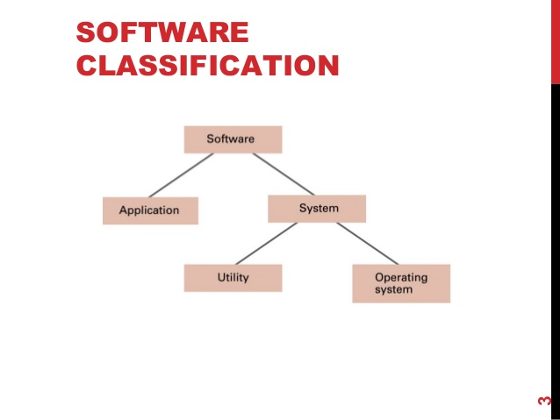
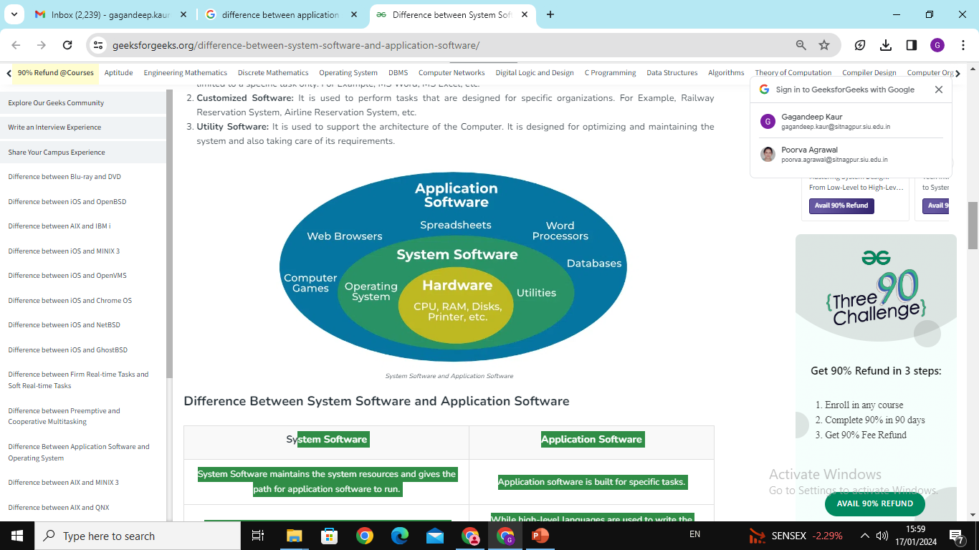

Slide 26
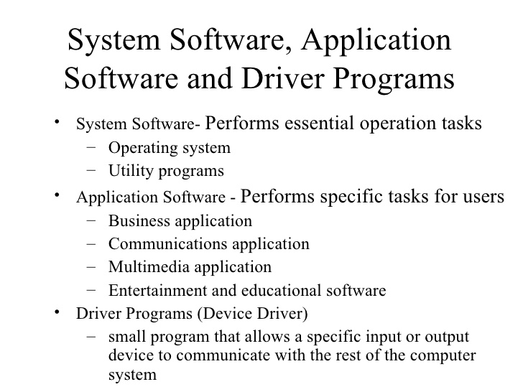

Slide 27
System Software | Application Software
System Software maintains the system resources and gives the path for application software to run. | Application software is built for specific tasks.
Low-level languages are used to write the system software. | While high-level languages are used to write the application software.
It is general-purpose software. | While it’s a specific purpose software.
Without system software, the system stops and can’t run. | While Without application software system always runs.
System software runs when the system is turned on and stops when the system is turned off. | While application software runs as per the user’s request.
System Software programming is more complex than application software. | Application software programming is simpler in comparison to system software.
The Software that is designed to control, integrate and manage the individual hardware components and application software is known as system software. | A set of computer programs installed in the user’s system and designed to perform a specific task is known as application software.
The system software has no interaction with users. It serves as an interface between hardware and the end user. | Application software connects an intermediary between the user and the computer.
System software runs independently. | Application software is dependent on system software because they need a set platform for its functioning.

Slide 28
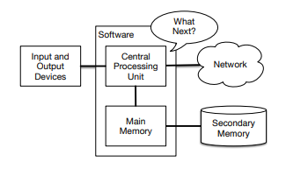
Computer Hardware Architecture
Lets see how computes are built:
CPU: is built to be obsessed with “what is next?” If your computer is rated at 3.0 Gigahertz, it means that the CPU will ask “What next?” three billion times per second.
Main Memory: is used to store information that the CPU needs in a hurry. The main memory is nearly as fast as the CPU. But the information stored in the main memory vanishes when the computer is turned off.
Secondary Memory: is also used to store information, but it is much slower than the main memory. It can store information even when there is no power to the computer. Examples of secondary memory are disk drives or flash memory (typically found in USB sticks and portable music players).
The Input and Output Devices are simply our screen, keyboard, mouse, microphone, speaker, touchpad, etc.
Network Connection to retrieve information over a network.

Slide 29
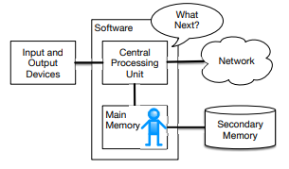
Why Programming?
As a programmer you will mostly be “talking” to the CPU and telling it what to do next. Sometimes you will tell the CPU to use the main memory, secondary memory, network, or the input/output devices.
You need to be the person who answers the CPU’s “What next?” question.
It would be very uncomfortable to shrink you down to 5mm tall and insert you into the computer just so you could issue a command three billion times per second.
So instead, we write down the instructions in advance. We call these stored instructions a program and the act of writing these instructions down and getting the instructions to be correct programming.

Slide 30
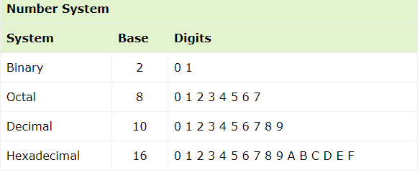
Data Representation
Computer does not understand human language. Any data, viz., letters, symbols, pictures, audio, videos, etc., fed to computer should be converted to machine language first. Computers represent data in three forms − Number system, Bits and Bytes, Text Code
Number System: To a computer, everything is a number, i.e., alphabets, pictures, sounds, etc., are numbers. Number system is categorized into four types −
Bits and Bytes: Bits − A bit is a smallest possible unit of data that a computer can recognize or use. Computer usually uses bits in groups. Bytes − group of eight bits is called a byte. Half a byte is called a nibble.
Text Code
Text code is format used commonly to represent alphabets, punctuation marks and other symbols. Four most popular text code systems are − EBCDIC, ASCII, Extended ASCII, Unicode

Slide 31
Data Representation
EBCDIC
Extended Binary Coded Decimal Interchange Code is an 8-bit code that defines 256 symbols.
ASCII
American Standard Code for Information Interchange is an 8-bit code that specifies character values from 0 to 127.
Extended ASCII
Extended American Standard Code for Information Interchange is an 8-bit code that specifies character values from 128 to 255.
Unicode
Unicode Worldwide Character Standard uses 4 to 32 bits to represent letters, numbers and symbol.

Slide 32
“The only way to learn New Programming language is by writing programs in it”
– Dennis Ritchie
Thank You!

